Slide 1




"Empowering Your Trading Journey: Explore, Trade, Thrive."

Slide 2

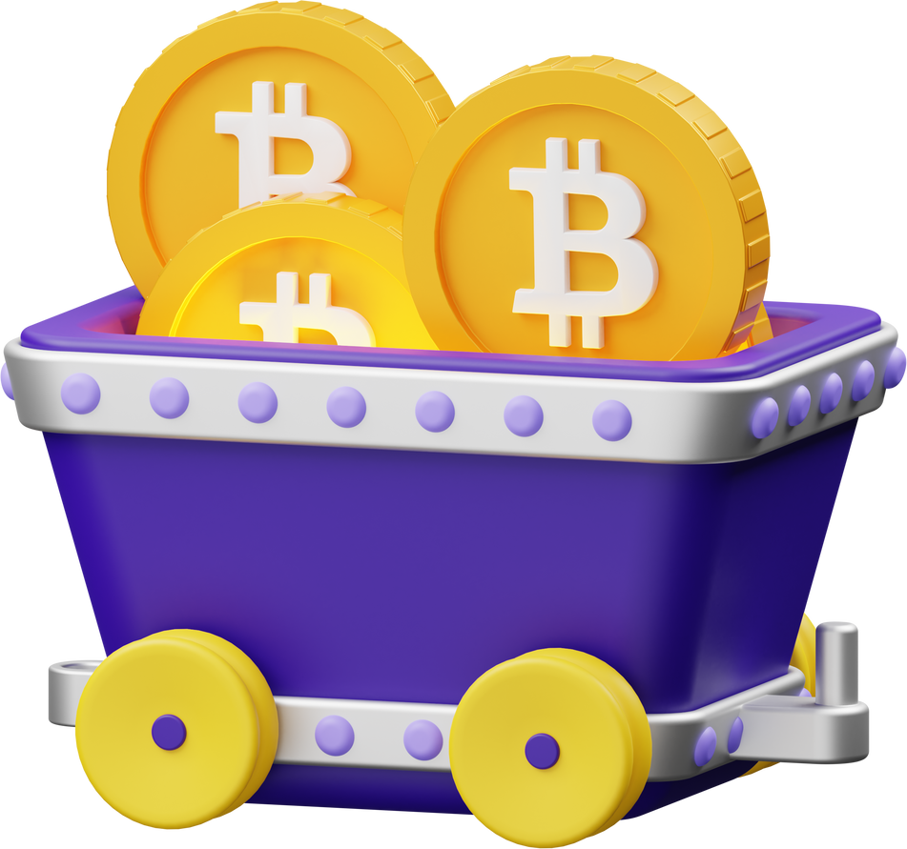
Introduction
Welcome to Stellar, your gateway to seamless and secure trading guide. Whether you're a beginner trader looking to explore the world of markets or an experienced trader seeking advanced tools and insights, Stellar offers a comprehensive platform tailored to meet your trading needs.
Next slide

Slide 3




System Overview
Stellar Trading is an all-inclusive platform that helps users keep informed about market movements by giving real-time prices for stocks, currency, cryptocurrencies, and other financial products. In addition to sophisticated technical analysis tools and equipment to support well-informed decision-making, the platform incorporates news feeds to notify users of the most recent changes in the economy that are relevant to these instruments.
Next slide

Slide 4
Problem Statement
Following the banning of the Binance platform in the Philippines, there is a pressing need for a reliable and user-friendly alternative trading website that caters to Filipino market trader investors.
Solution
This platform should provide seamless and easy-to-understand functionality, robust security measures, and linkage to a secure trading option to ensure a smooth transition and continued access to market trading for Filipino users.
Next slide

Slide 5

Design Progress
Stellar Trading Platform, a user-friendly website offering real-time trading information, involves several key steps centered around data from TradingView. First, we gather input and insights from traders to understand their needs. Then, we create a basic layout and design mock-ups to ensure easy navigation and a pleasant user experience. The platform's main feature is the integration of TradingView's tools, such as charts, heatmaps, and an economic calendar, so users get up-to-the-minute market data. During development, we use reliable connections to pull in TradingView's data accurately. We also make sure users can customize their dashboards to suit their trading styles. Extensive testing is done to ensure everything works smoothly.
Brainstorming
Planning
Design
Testing
Ideas Combined
Sharing of Plans
Organizing
Preparation
Lay out
Mock-ups
Conclusions
Debugging
Pilot Testing
Next slide

Slide 6
Design Timeline
Brainstorming
Ideas Combined
Sharing of Plans
Days
Planning
1-3
20%
Organizing
Preparation
4-7
38%
Designing
8-12
81%
Lay out
Mock-ups
13-18
19-21
100%
Testing
Conclusions
Debugging
Pilot Testing
Next slide

Slide 7
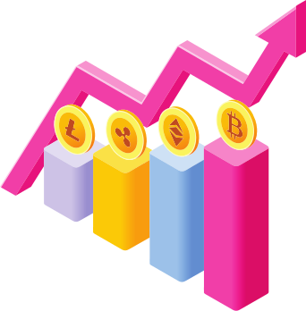
User Research
The inputs and insights of traders – mainly our friends and classmates who are in beginner to mid-level knowledge in trading provides noteworthy suggestions that inspired our ideas. The main objective of Stellar Trading Platform is to provide a
user-friendly and beginner-friendly trading platform as an alternative to Binance.
The main questions asked to traders that inspires the whole idea of Stellar are:
1. What are the functionalities that you mostly use in trading?
2. What is your preference in terms of design and performance?
3. What are your ideas and suggestions?
The development of Stellar Trading Platform was inspired by the inputs and insights of traders and our objective. These are the keys that lead us to design the whole platform to meet the ideas and suggestions of different traders, providing them the straightforward platform.
Next slide

Slide 8


Target Audiences
Beginner Traders
Experienced Traders
Trading Enthusiast
Beginner traders are individuals who are new to the world of trading. They are eager to learn and understand the basics of trading, often feeling overwhelmed by the complexities of the market.
Seasoned traders with a deep understanding of markets. Seek advanced tools for technical analysis and trading strategies.
Enthusiasts deeply passionate about markets and trading. Constantly seeking new insights, trends, and opportunities.
Next slide

Slide 9
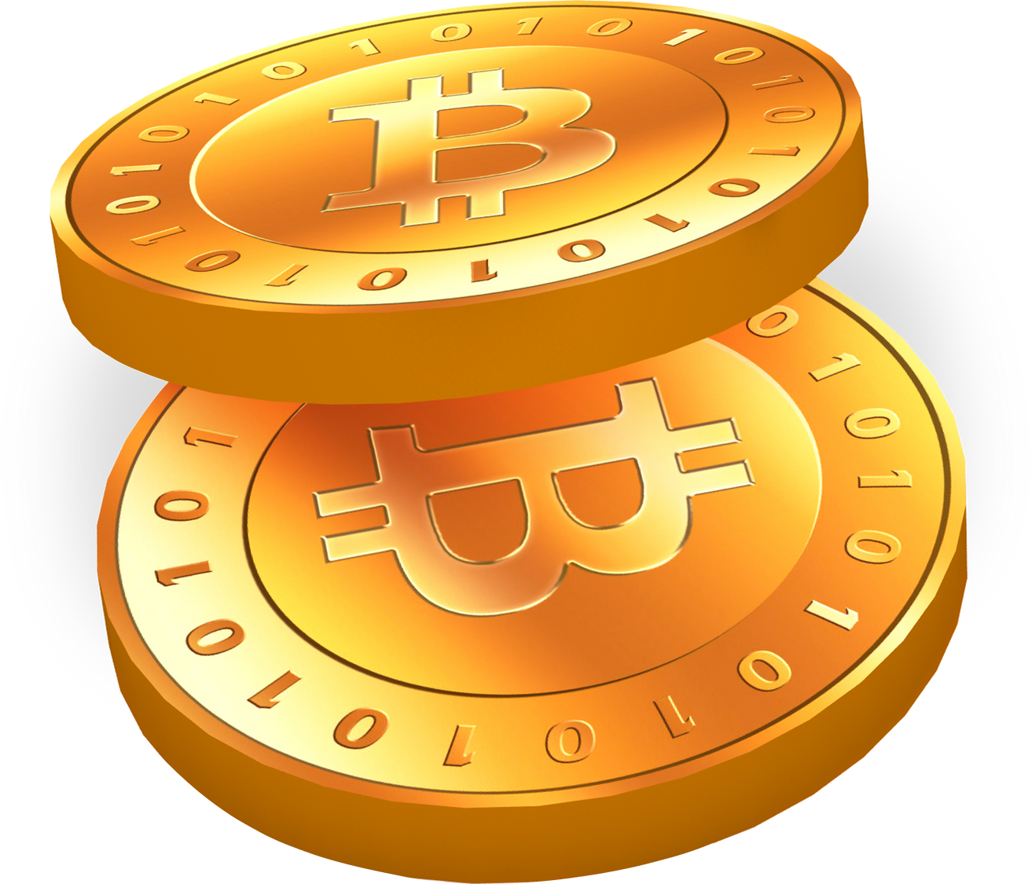
Features
Website Features for Users
News Headline
Screeners
Script generates real-time market news based linked to the whole stories in TradingView.
A script which is powerful tool that filter and identify potential trading opportunities based on specific criteria.
Trading Tutorials
Charting
A collection of straightforward trading guides from various Youtube channels that will help
users
to understand trading.
An advanced tool that offers range of powerful tools and features designed to help traders and investors analyze financial markets.
Heatmaps
Provides a visual representation of market performance, helping traders and investors quickly identify trends and anomalies.
Next slide

Slide 10
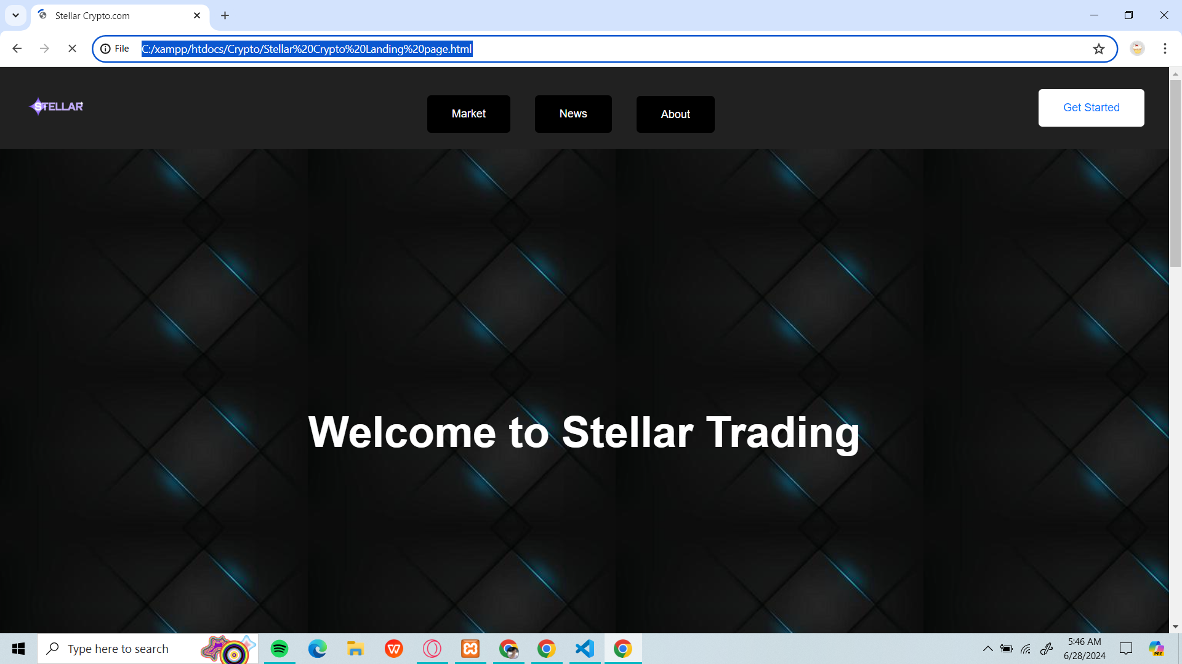

Slide 11
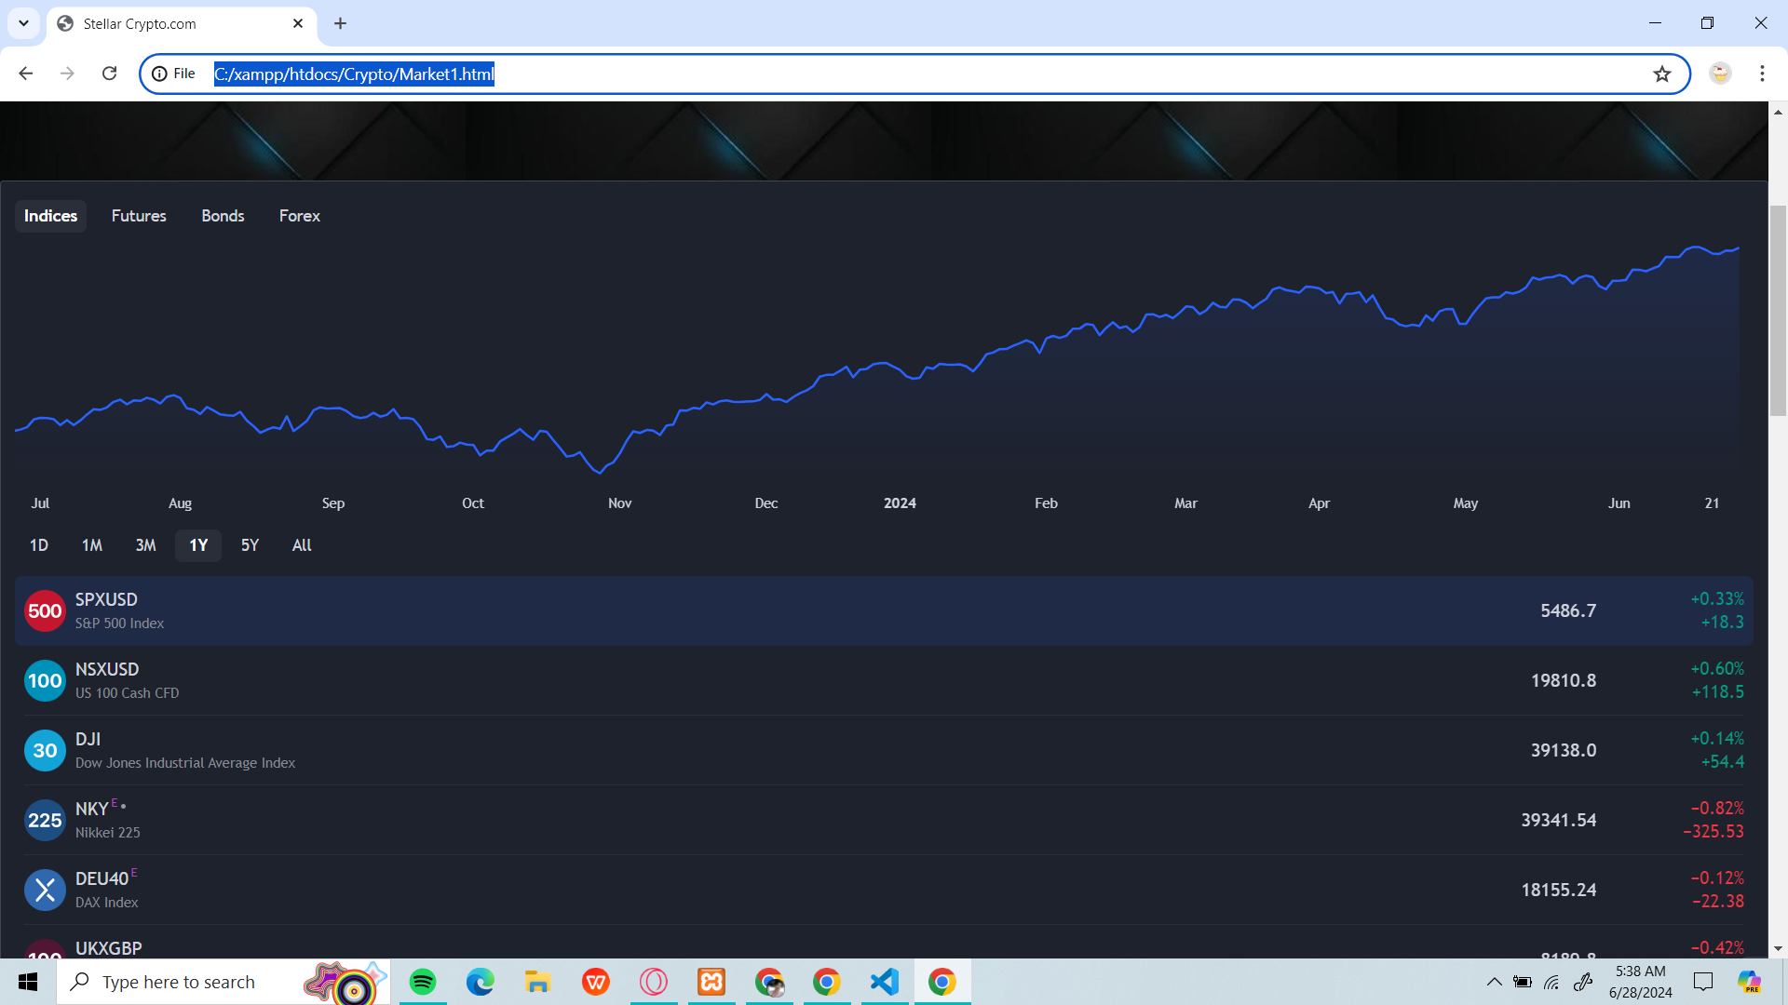

Slide 12
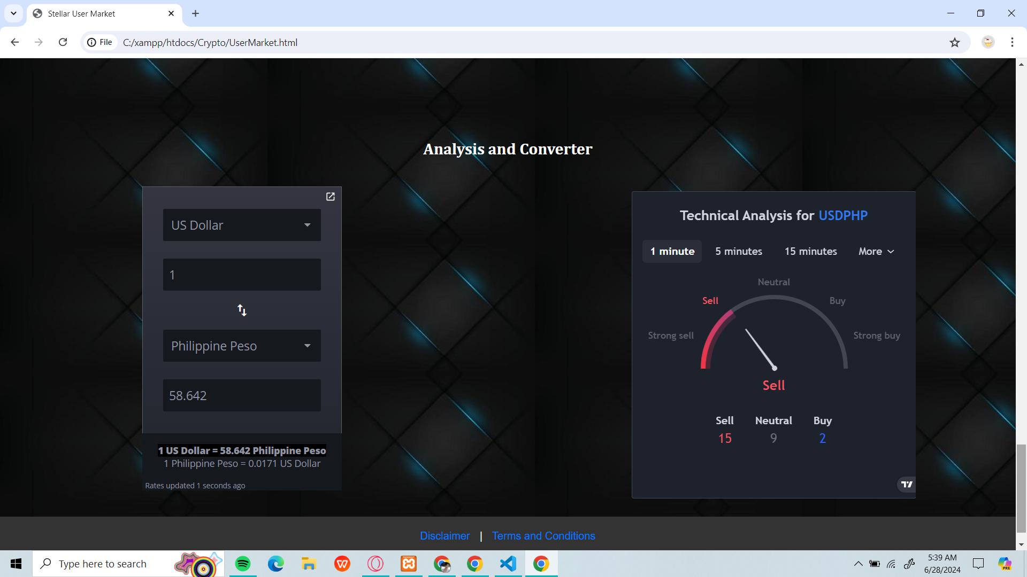

Slide 13
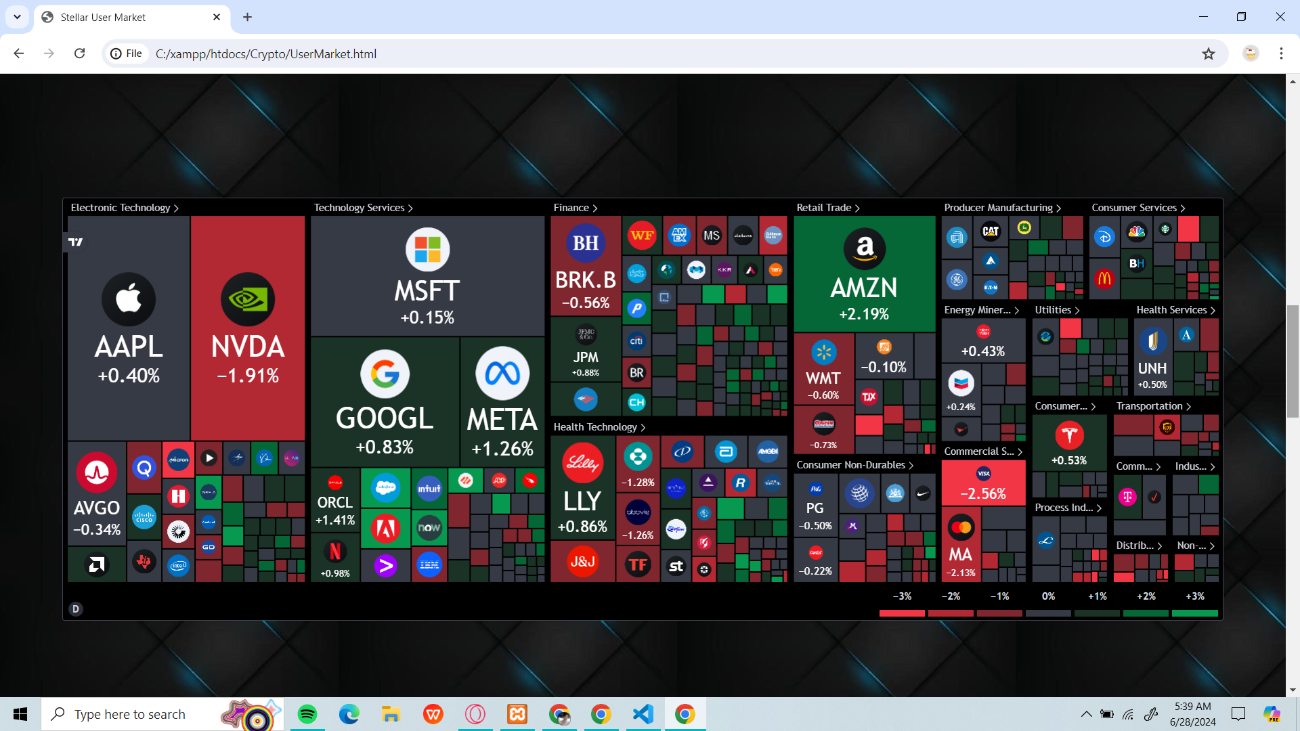

Slide 14
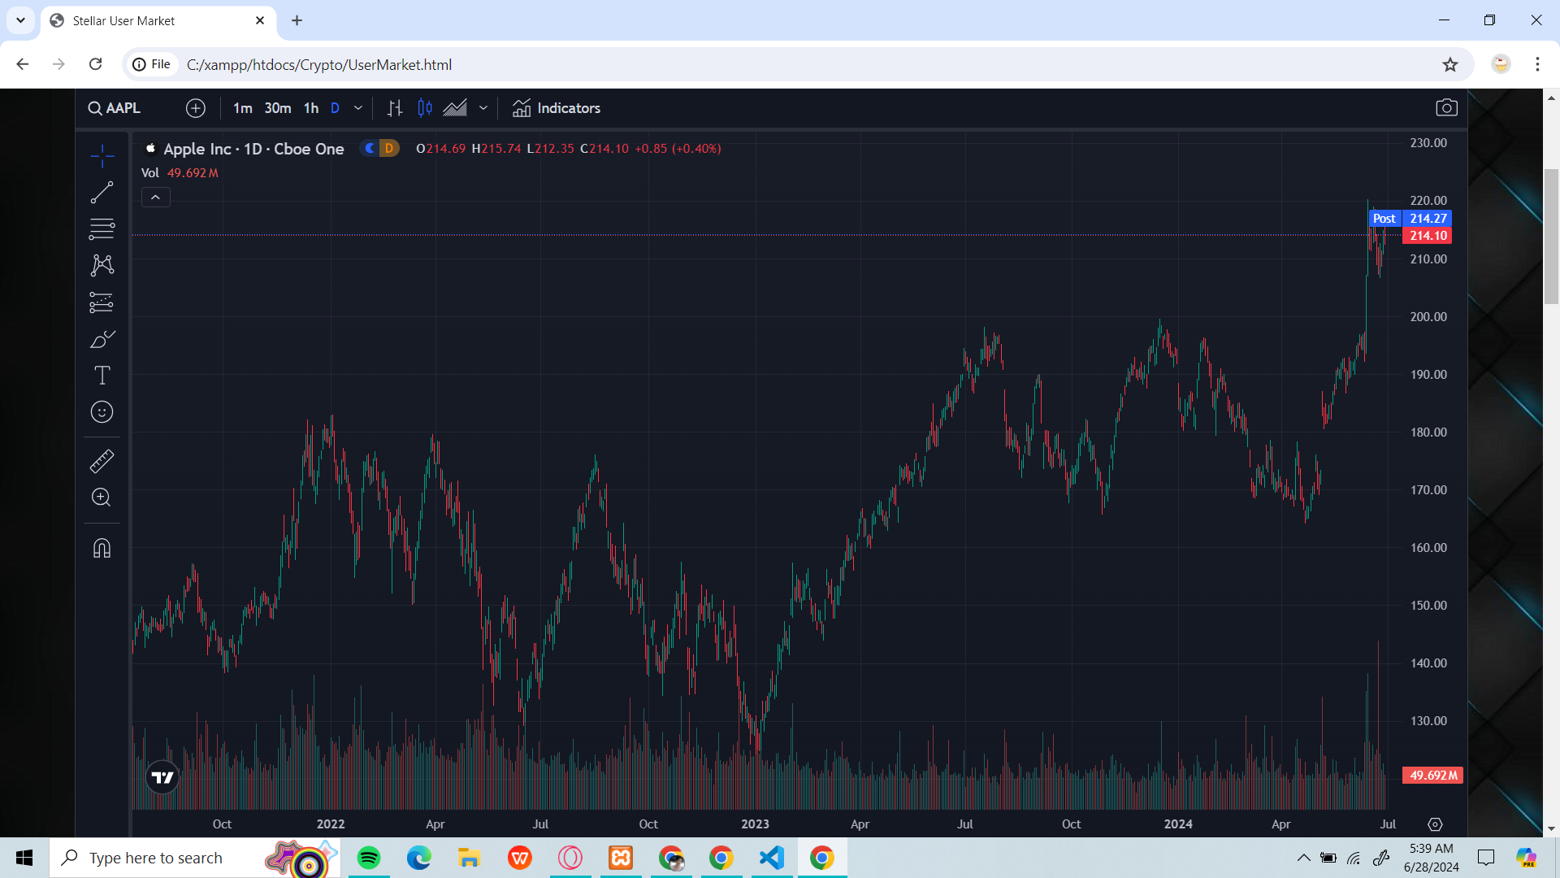

Slide 15
User Flow
START
VIEW LANDING PAGE
GETTING STARTED (YES/NO)
LOGIN (YES/NO)
CREATE ACCOUNT
VIEW MARKET
NEWS
LOGIN
VIEW CHARTS
LOGOUT
Next slide
END

Slide 16
Modules
4. Market Page
A free to all page that provides Watchlist functionality about Indices, Futures, Bonds and even Forex.
Includes Screener tables about Forex and Crypto that shows real-time data about its prices, changes, and more.
5. About Page
A page that shows different articles that provide user more knowledge about specific topics - these topics are linked to a third-party website that provides information
6. Chartings Page
Charting: An advanced tool that offers range of powerful tools and features designed to help traders and investors analyze financial markets.
Heatmaps: Provides a visual representation of market performance, helping traders and investors quickly identify trends and anomalies.
1. User Management
User Registration: Allows new user (beginners, experienced, and enthusiasts traders) to register.
User Authentication: Login functionality.
User Role: Access registered-user level of functions.
2. Home Page Tutorials
Provides clear and easy-to-understand guides for beginner users.
3. News Page
Provides quick data on different forex and crypto coins.
Shows News Headlines in all aspects of trading in real time.
Includes Economic Calendar that provides traders and investors with a comprehensive schedule of upcoming economic events and data releases.
Next slide

Slide 17

THANK YOU!

